Slide 1
Applications of Wearable Technology in Tennis
Thomas Perri
Research Fellow - University of Technology Sydney and Tennis Australia
Presented to Tennis Australia Performance on March 24, 2022
Supervisors – Professor Rob Duffield, Associate Professor Machar Reid, Dr Alistair Murphy

Slide 2
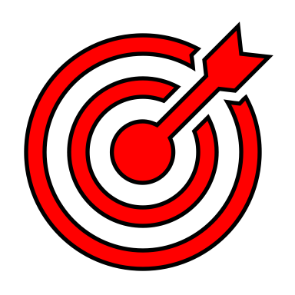
PhD Study Aims
Validate a prototype algorithm from wearable technology for automatic stroke event detection
  Manually code and categorise 5349 strokes
Analyse stroke and movement Player Load profiles during match-play contexts
  Compare between court surface and winning vs. losing
Compare stroke and movement Player Load profiles in common tennis training drills
  Compare between eight common training drill categories

Slide 3
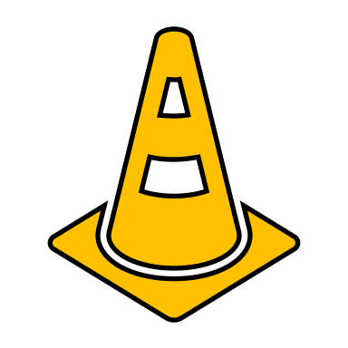


PhD Study Findings - Validation
Match-level
No Significant Differences
  Total strokes
  Forehands
  Backhands
  Serves
Forehand Stroke | Accuracy (%) (n)
FH drive | 94% (n=1743)
FH end-range | 27% (n=223)
FH slice | 22% (n=73)
FH block | 20% (n=5)
FH volley | 17% (n=72)
FH shadow swing | 5% (n=55)
FH dig | 0% (n=3)
FH drop shot | 0% (n=2)
Backhand Stroke | Accuracy (%) (n)
BH drive | 86% (n=1438)
BH slice | 35% (n=214)
BH end range | 19% (n=145)
BH dig | 17% (n=6)
BH shadow swing | 9% (n=91)
BH volley | 5% (n=65)
BH block | 0% (n=6)
Acceptable for use in Study 4 and Study 5

Slide 4
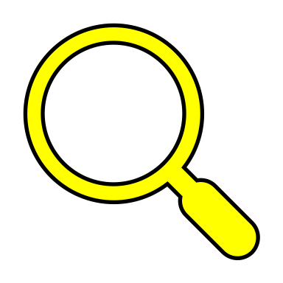
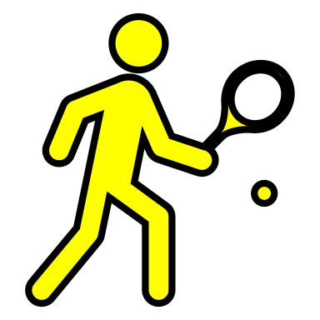

PhD Study Findings – Match-Play
↑hitting actions in hard courts (21 ±5% vs. 17 ±2%)
↑hitting demands on hard courts
↑FH dominance on hard courts
How would tennis explain these findings? (Court Surface)
↓rally lengths on grass ∴ ↓physical demands
↑ball bounce on hard courts ∴ ↑time for FH strokes _{(Brabenec 2001)}
Similar locomotor strategies across surface _{(Maquirriain 2013)}
Previous tennis research: (Match Outcome)
No difference in PL
No difference in average acceleration (g)
↑2-4 m per point during winning points
tPL = total player load, mPL = movement player load, sPL = stroke player load, FH = forehand, BH = backhand, Other = “Other stroke”

Slide 5
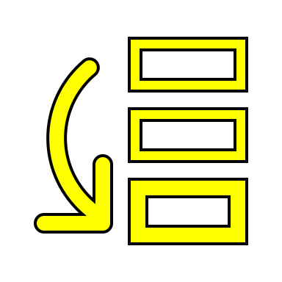
PhD Study Findings - Training
Total PlayerLoad
Accuracy
Recovery/Defensive
Open
2v1 Net
2v1 Baseline
Points
Technical
Match-Play
Stroke PlayerLoad
Accuracy
Recovery/Defensive
2v1 Net
Open
2v1 Baseline
Points
Technical
Match-Play
Movement PlayerLoad
Accuracy
Recovery/Defensive
Open
2v1 Baseline
Technical
2v1 Net
Points
Match-Play
Forehand / Backhands
Accuracy
Recovery/Defensive
Open
2v1 Baseline
2v1 Net
Technical
Points
Match-Play
Serve
Technical
Match-Play
Accuracy
Points
2v1 Net
Open
Recovery/Defensive
2v1 Baseline
*Accuracy drills significantly highest for sPL and FH-sPL
Suggests mechanical stress from trunk rotations are ↑
Advantage vs. relying on stroke counts _{(Murphy et al. 2014)}

Slide 6
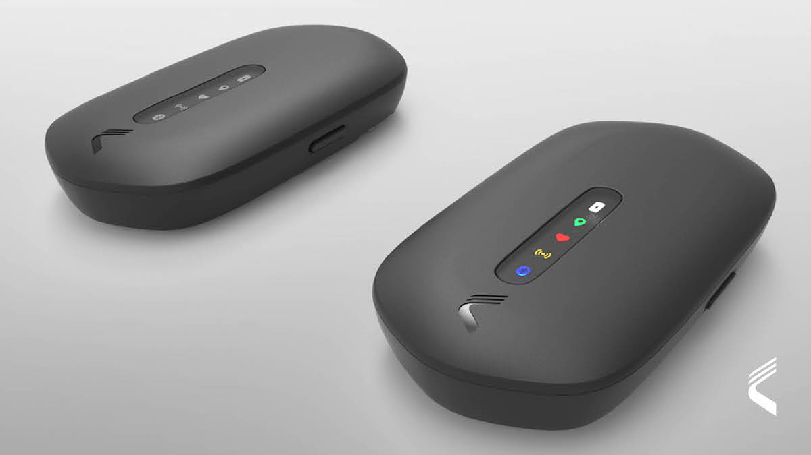
Wearable Technology and the NTA – Why?
All healthy and rehab players to wear Catapult GPS in training
  Training live coded for all drills
  Session analysed within 30 minutes and feedback to coaches and players via Smartabase
Why?
  Understand physical ‘cost’ of training sessions and drills over time
  Identify high-risk loading characteristics of rehabbing players
  Design better training sessions to mimic highest level of match-play and repeat over time

Slide 7
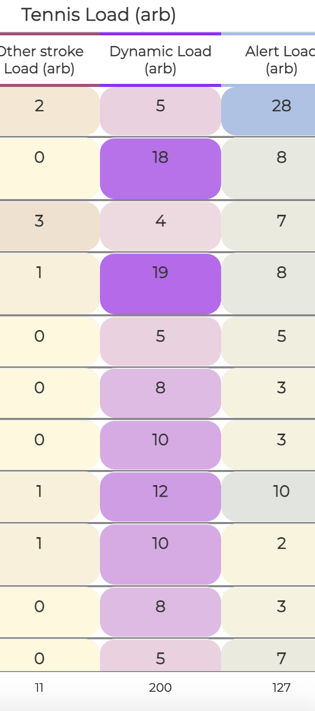
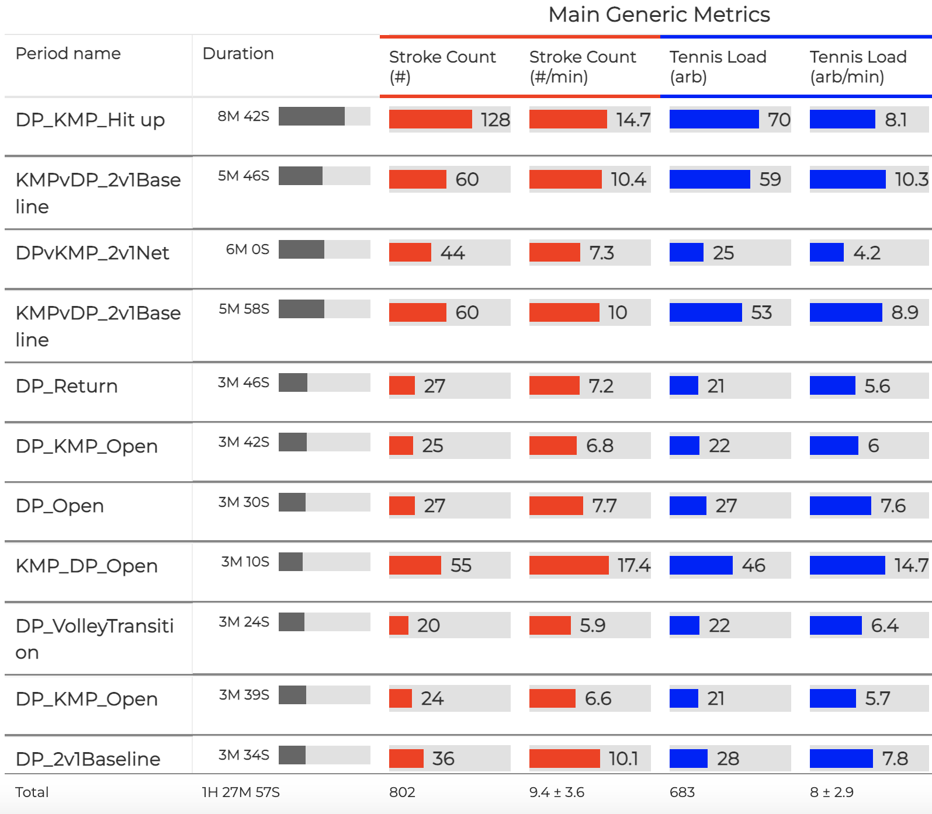
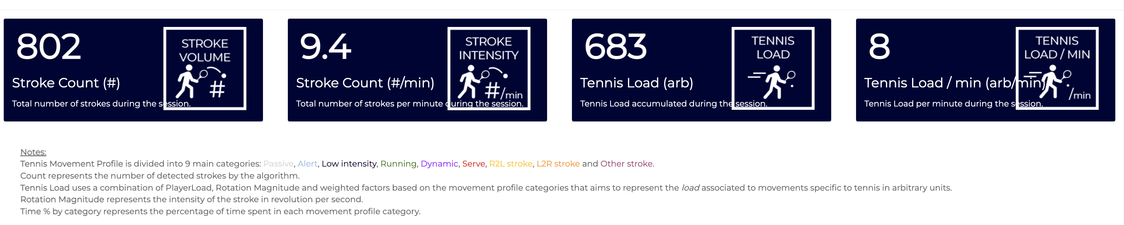
Wearable Technology and the NTA – How?
Customised web-based plugin from Catapult Sports
Developed from revised validation work
  Refined categorisation of tennis movement actions

Slide 8
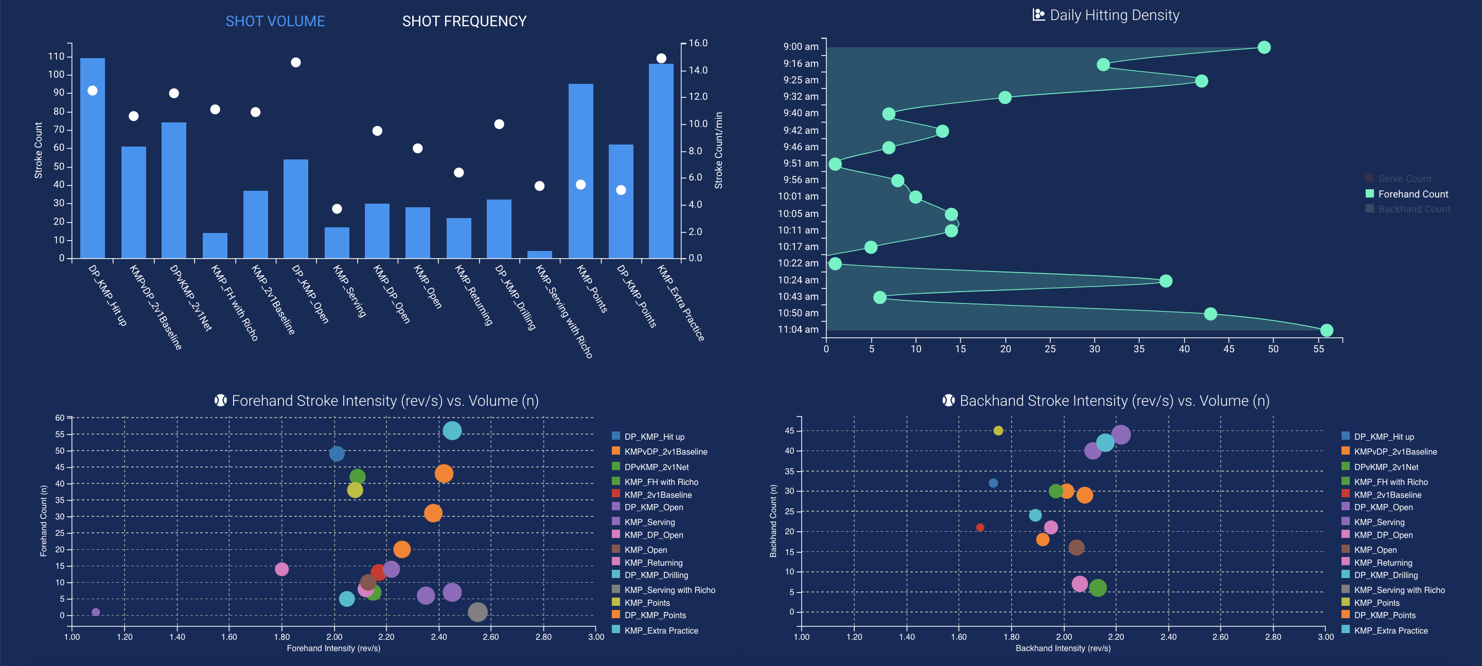
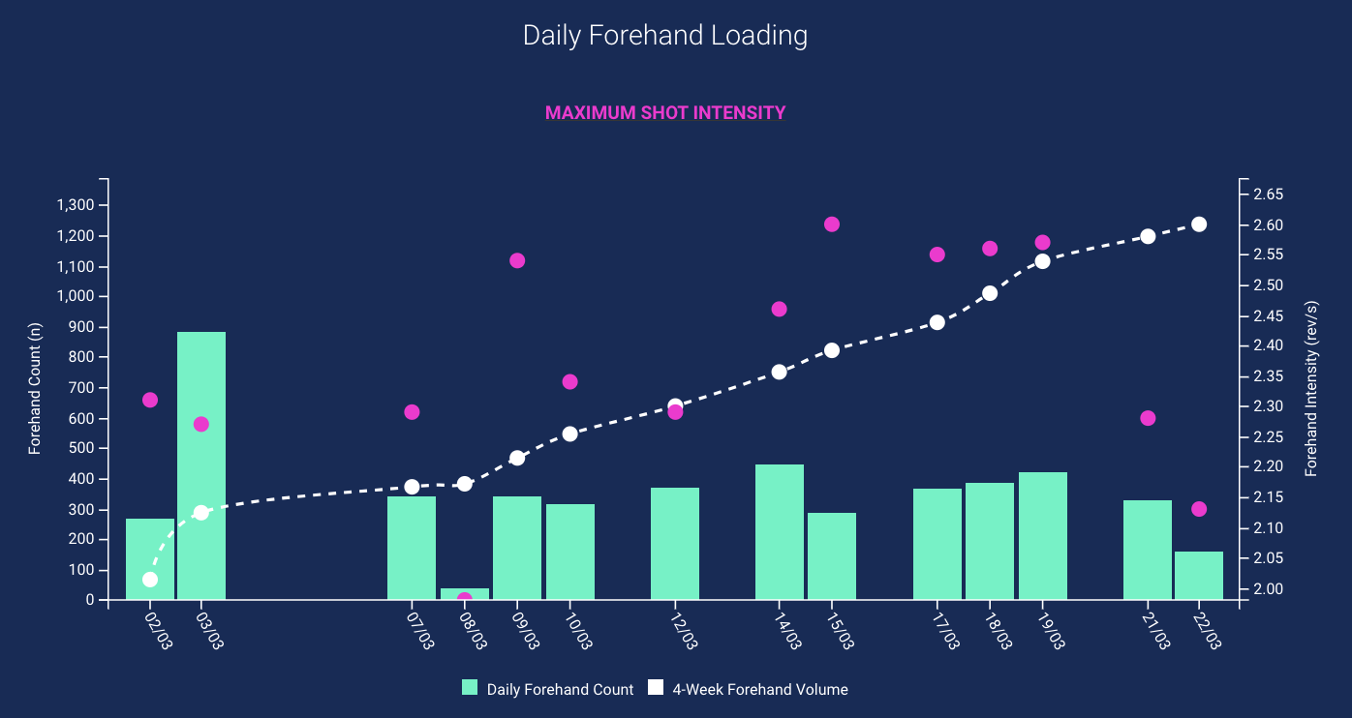
Wearable Technology and the NTA – Practical Application
All player data housed in Smartabase through customised collection forms and dashboards
Example below

Slide 9
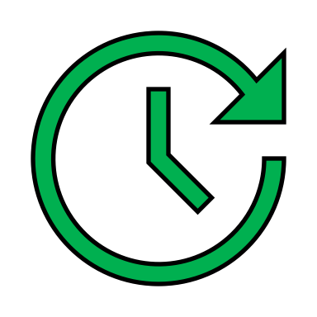
What’s Next and Ongoing Strategies?
Develop systems for efficient data collection and housing
  Smartabase + Vision
Daily ‘fast’ insights to coaches and players to reflect and refine training
  Enhance athlete engagement in the training process
Long-term ‘slow’ research projects to improve understanding of metrics
  e.g., Individualised shot ‘intensity’ thresholds
  Future ‘best-practice’ rehab from integrated technology insights (e.g., IMU, HawkEye)

